Slide 1

General Assembly Data Science-45 Cellar Tracker: From Tasting Notes to Ratings
Mitsos Triantopoulos | Final Project | 09 February 2017

Slide 2
Executive summary
The hypothesis is that we can use the text of the wine reviews, feed it to a Natural Language Processing algorithm model to predict the rating of the wine.
I worked with a dataset from the online wine cellar management database cellartracker.com.
Review/tasting language and ratings/categories. I looked at the relation between the text of the user reviews and the rating they gave to their wines. When using the tasting notes from all the wine types
Wine type. Adjusting the focus of the study to wines of the same type (color, grape, region) increases the cross-validation score
Reviewer. Adjusting the focus to a few (or even just one) reviewers increases the cross-validation scores
Results and next steps. The cross-validation scores reached 80%. The test set had a success of 84%

Slide 3
Contents
Background
Dataset
Data model
Conclusion

Slide 4



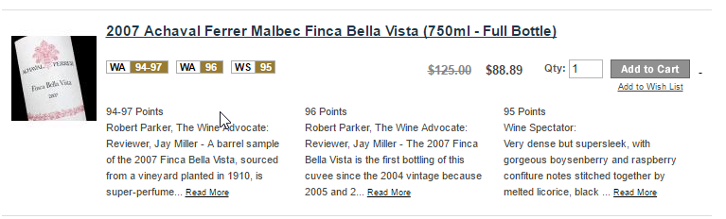
Background
Unit of measure
The web has created a huge wine market with an ever-growing collection of blogs, professional critics, magazines and other electronic publications. The American wine critic Robert Parker introduced the 100-point rating scale in the 1970s and most publications and critics nowadays use this scale to rate wines
High quality wines bring high ratings from the well-known and trusted publications which results in higher demand for the wines, as well as increased prices in the wine market.
Many of the publications such as Wine Spectator and the Wine Advocate only reveal the point values to paid subscribers.
What if we could predict the ratings of wines?
→ enjoy better wine for less $ (for those who enjoy drinking it)
→ better investment (for those who collect)
SOURCE: Source

Slide 5
Contents
Background
Dataset
Data model
Conclusion

Slide 6

My data set – cellartracker.com
Cellar Tracker is an online cellar management tool. Users input their wine collection and they keep track of when they purchased the wines, they write reviews (tasting notes) when they consume them and they also include their point ratings (again, they use the 100-point scale¹)
The dataset I worked with contains just above 2 million entries. It is a text file in the following format, 10 lines per entry → more than 20 million lines of text
1 wine/name: 1981 Ch&#226;teau de Beaucastel Ch&#226;teauneuf-du-Pape
2 wine/wineId: 18856
3 wine/variant: Red Rhone Blend
4 wine/year: 1981
5 review/points: 96
6 review/time: 1160179200
7 review/userId: 1
8 review/userName: Eric
9 review/text: Olive, horse sweat, dirty saddle, and smoke. This actually got quite a bit more spicy and expressive with significant aeration. This was a little dry on the palate first but filled out considerably in time, lovely, loaded with tapenade, leather, dry and powerful, very black olive, meaty. This improved considerably the longer it was open. A terrific bottle of 1981, 96+ and improving. This may well be my favorite vintage of Beau except for perhaps the 1990.
10
1 Even though the scale is from 0 to 100, most wines receive points between 80 and 100. A wine with a score below 80 is, usually, a bad wine – not “cellar worthy”

Slide 7

Data Cleanup – Challenge #1
1 wine/name: 1981 Ch&#226;teau de Beaucastel Ch&#226;teauneuf-du-Pape
2 wine/wineId: 18856
3 wine/variant: Red Rhone Blend
4 wine/year: 1981
5 review/points: 96
6 review/time: 1160179200
7 review/userId: 1
8 review/userName: Eric
9 review/text: Olive, horse sweat, dirty saddle, and smoke. This actually got quite a bit more spicy and expressive with significant aeration. This was a little dry on the palate first but filled out considerably in time, lovely, loaded with tapenade, leather, dry and powerful, very black olive, meaty. This improved considerably the longer it was open. A terrific bottle of 1981, 96+ and improving. This may well be my favorite vintage of Beau except for perhaps the 1990.
10
A/a
A/a
B/b
B/b
C/c
→ etc.
Global search and replace on a text file of 20 million lines
→ 10 minutes, each letter

Slide 8
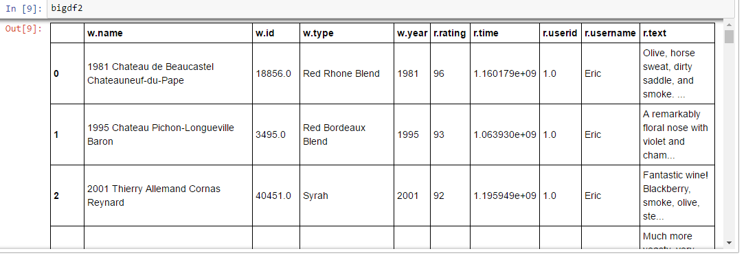
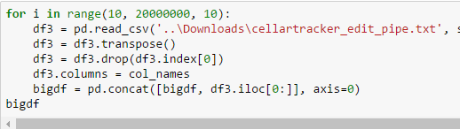
Data cleanup – Challenge #2
So, I wrote a loop that reads 10 lines at a time and then adds the data to a pandas dataframe.
It worked fine for the first few rows…
When I tried to read in 20 million lines (i.e. 2 million pandas rows) all the data, my PC did not cooperate ☺

Slide 9
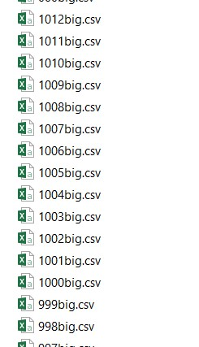
Data cleanup – Challenge #2 (cont’d)
1. Split the original data file to 1012 txt files
2. Read each txt file, create a dataframe and save to csv
3. Write loop that reads the CSV files and appends each to the “big” dataframe
4. Result:
Success - Loaded a dataframe of 2,024,995 rows, 10 columns
Not success - There was not much I could do with it because all my memory was being used
5. Solution: work with random subset of the larger dataset – 100k-300k rows

Slide 10
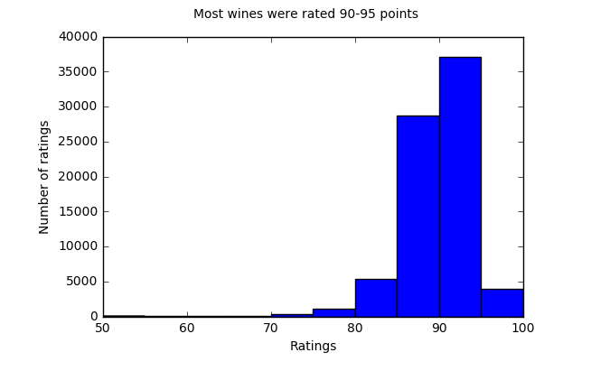
An overview of the ratings distribution
As expected, most “cellar-worthy” wines were rated above 85 points, with the highest number between 90-95. Above 95 are the exceptional and collectible ones.

Slide 11
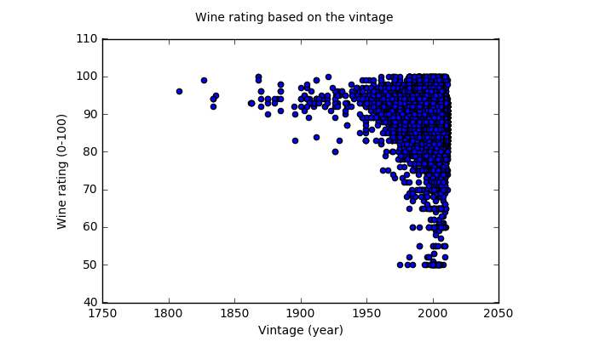
Vintage
Even though the distribution of points is very scattered – there is a general trend that “older tends to rate higher” – this is to be expected, as the wines that have the potential to age are the ones that are generally rated higher (and have higher price).

Slide 12
Contents
Background
Dataset
Data model
Conclusion

Slide 13
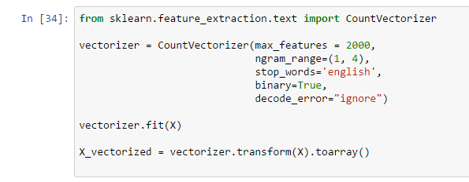
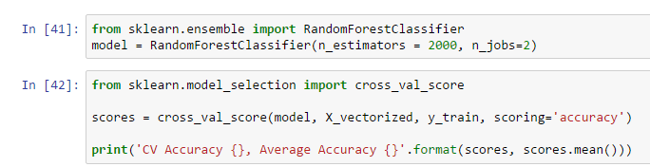
Random Forest and Count Vectorizer
Text was vectorized using CountVectorizer, with 2000 features and 1-grams, 2-grams, and 3-grams
Random forest:

Slide 14
Natural Language Processing (NLP) on the reviews/tasting notes
I used the methods we used during class 14 (where we used NLP to predict the “greenness” of websites)
First round of tests: very low cross validation scores: in the 30% accuracy range
So, I decided to go back and look at my data: I was using all the reviews of all wines: red, white, sparkling, fortified, dessert
I decided to:
Focus only on one wine type
Focus on the length of the reviews
Average length is 37 words
The reviewers: how many reviews have they written (are they “experts”?)
Convert the ratings to categories:
Up to 80 pts → OK
81-89 pts → Good
90-95 pts → Very Good
96-100 pts → Collectible
1. Select/refine the data (user, wine type, word count)
2. CountVectorizer choose # of words/features (1000 – 5000)
This process was executed multiple times
5. Cross Validation
3. CountVectorizer choose # of n-grams (1 to 3)
4. CountVectorizer to Random Forest

Slide 15
Feature & strategy adjustments
Adjust Review Length
Adjust Wine Type
Adjust Review Length (again)
Adjust Review Length
Limited to reviews that were longer than 20 words
Thinking: lengthier reviews take more effort to describe the wine accurately
Result: no improvement in the cross-validation scores
Limited wines to Cabernet Sauvignon only.
Thinking: Red wines and white wines are reviewed using very different vocabulary
Result: Increase in cross-validation scores
Limited reviews to those that were under 40 words
Thinking: shorter reviews tend to use smaller set of words
Result: Increase in cross-validation scores
Limited the reviewers
Thinking: I will get more consistent vocabulary
Found a user with 30,000 reviews! So I decided to use only one person’s tasting notes
Bull’s eye: 80% cross-validation score

Slide 16
Contents
Background
Dataset
Data model
Conclusion

Slide 17
Conclusion
We are able to predict the category rating of a wine when we have consistency in the source of the reviews and in the types of wines. For example, all reviews of Cabernet Sauvignon from “user 70”.
The next steps in such a study would be:
to use higher processing power to expand the user base (i.e. use 2-10 users, or of a single publication)
Expand the wine type (i.e. all West Coast reds)
Examine the evolution of reviewers (for example only use the reviews of a writer after they have written 100 reviews, say)
Considering that taste is a highly subjective matter it is a big challenge to convert qualitative features to a quantitative value such as a 0-100 rating.

